Slide 1


Analysis of car accidents in Newyork using Pandas, Matplotlib. Prof . Yousef Ahmed
By ,
Sandhyarani Kairam 700697169
Anirudh Sai Cherukuri 700701239
Abhishek Anala 700694646

Slide 2
Analysis of car accidents in New york using Pandas, Matplotlib.

Slide 3
Steps involved :
Data gathering and discovery
Data pre processing and cleaning
Data modelling and designing
Data visualization

Slide 4
Data set URL :
https://catalog.data.gov/dataset/motor-vehicle-crashes-case-information-beginning-2009

Slide 5
Data pre-processing and cleaning :
In the whole data , we have identified some of NULL values and unappropriated data .
So we removed all the unwanted data and in the NULL values we replaced them with two approaches
1) Considering other attributes, we found the mode of data and replaced the NULL value accordingly .
2) In the second case we have followed the forward filling approach i.e; replacing the unknown value with the succeeding value .

Slide 6
Data modelling and designing :
We have used three models in the project
1) Random forest :
Random forest, like its name implies, consists of a large number of individual decision trees that operate as an ensemble . Each individual tree in the random forest spits out a class prediction and the class with the most votes becomes our model’s prediction

Slide 7
2) Decision tree :
In this model we can be able to predict the accuracy and will be able to understand whether it is suitable or not .
3) K-means clustering :
In this we can group the similar attributes into clusters and shall be able to predict the possibilities and similarities between the attributes.

Slide 8

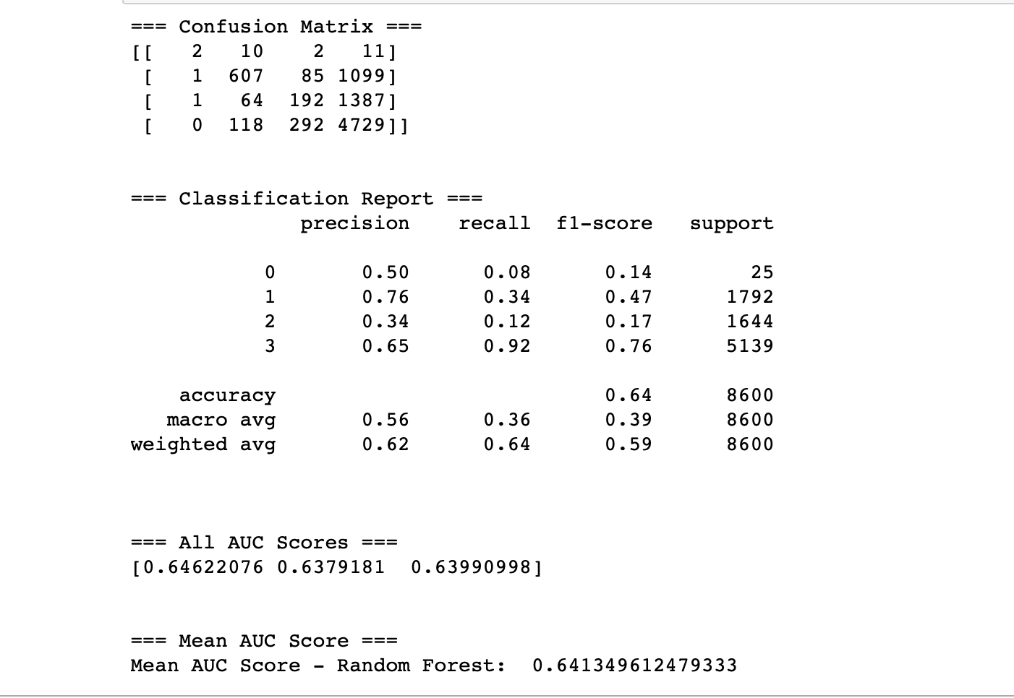
Random Forest output :

Slide 9
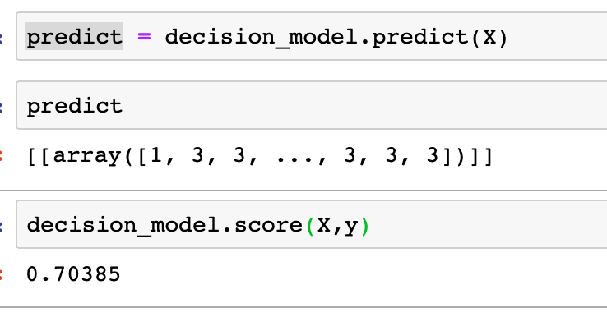
Decision tree output :

Slide 10
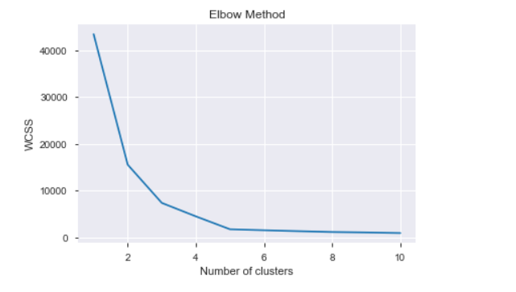
K-means clustering output :

Slide 11
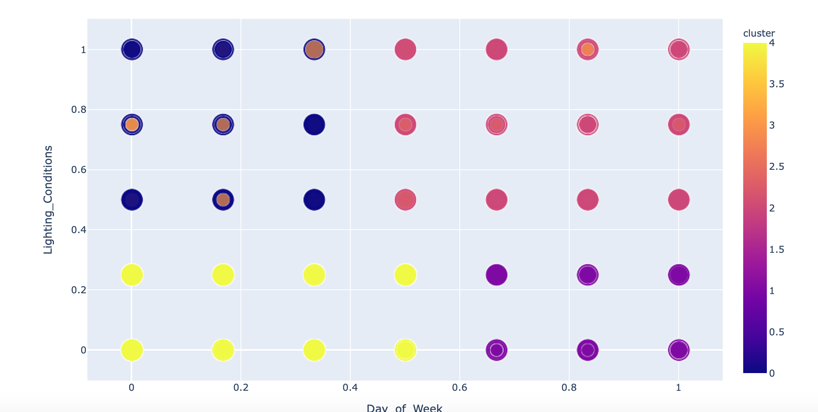
K-means clustering output :

Slide 12
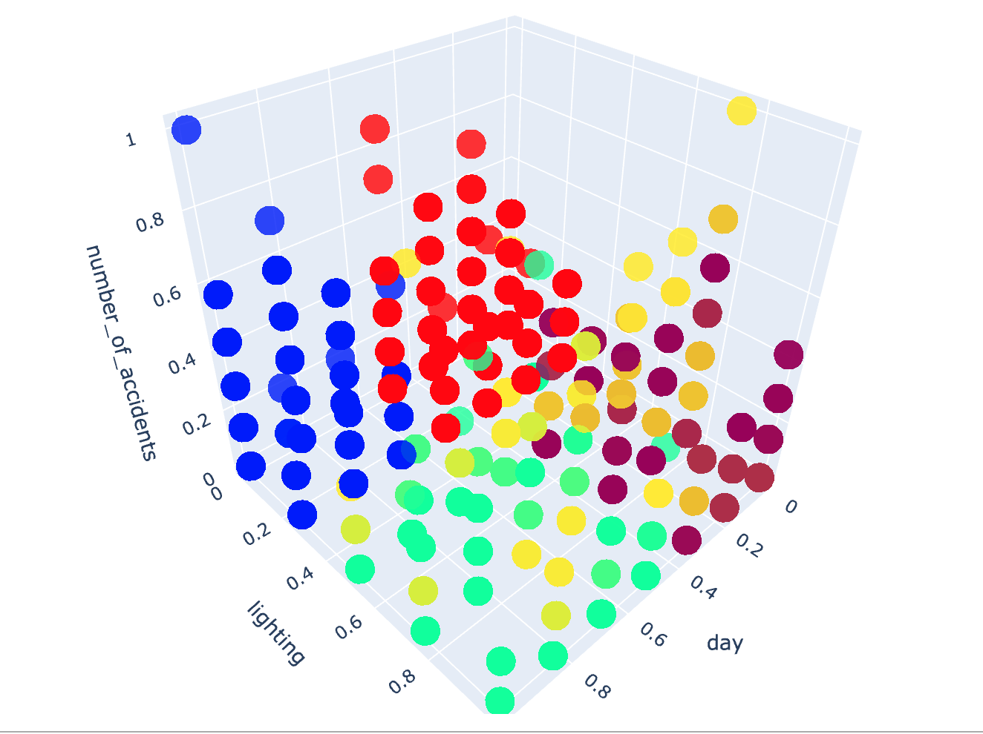
K-means clustering output :

Slide 13
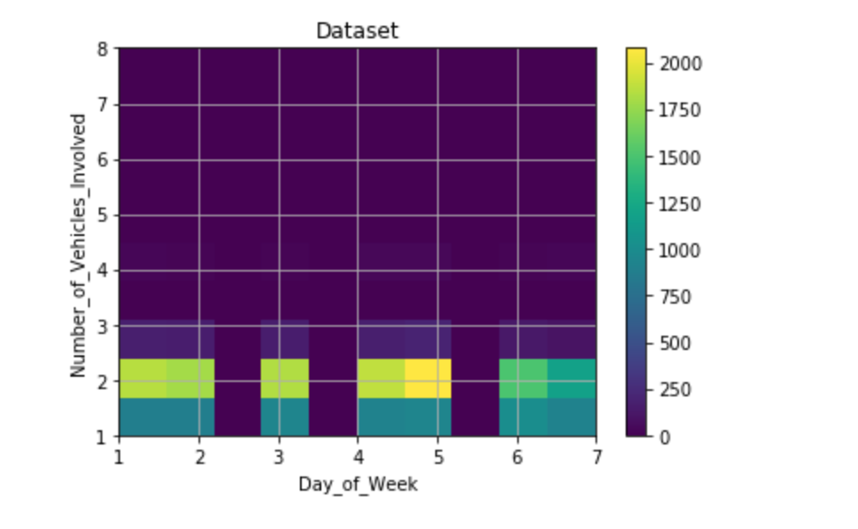
Data Visualization :

Slide 14
Thank you

